Slide 1
Project Video
Automatic Paper Assessment
Members: Jiwoo Park, Sumin Lim, Kyumin Park, Gyuseok Lee
Notes:
Hello, my name is Jiwoo Park and I’m the presenter of today’s video.
Our title is ‘Automatic Paper Assessment’.

Slide 2
Contents
1. Introduction
2. Task
3. Methods
4. Results and Discussion
5. Conclusions
Notes:
Here are today’s contents

Slide 3
Contents
1. Introduction
2. Task
3. Methods
4. Results and Discussion
5. Conclusions
Notes:
We start with the introduction

Slide 4
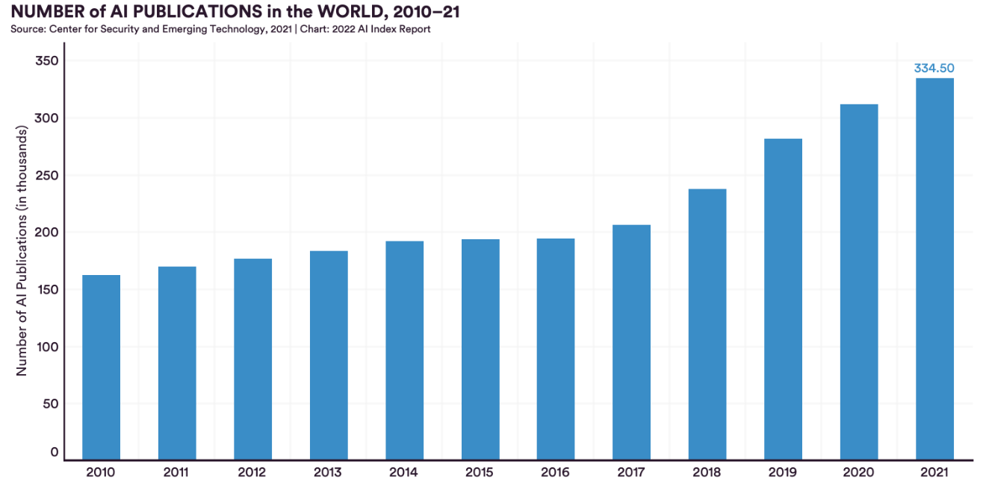
1. Introduction
Notes:
The number of AI papers published worldwide in 2021 is about 334,500(Three hundred and thirty four)
Realistically, reading all of these papers is close to impossible.
So, we want to analyze each of these numerous papers by reading less words than by reading the whole paper.

Slide 5

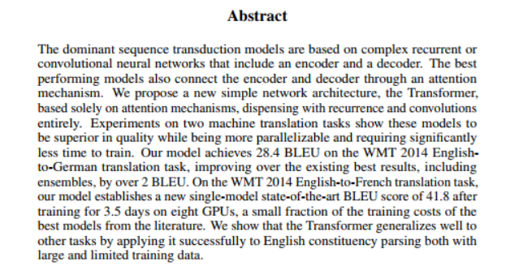
1. Introduction
Notes:
Therefore, we focus on the abstract of each paper.
We assumed that the abstract of each paper would contain most of the information needed to evaluate the paper.

Slide 6
1. Introduction (Problem Definition)
Abstract
Summarize in one sentence
Generate Strengths
Generate Weakness
Determine
Is_Accepted
Notes:
So, our problems that we want to solve are 4 tasks using the abstract
First, we want to summarize the paper in one sentence
Second, we want to generate strengths
Third, we want to generate weakness
Lastly, we want to determine whether it is accepted or not

Slide 7
Contents
1. Introduction
2. Task
3. Methods
4. Results and Discussion
5. Conclusions
Notes:
Now, we’re gonna explain more about our task

Slide 8
2. Task (Novelty)
There have been several attempts to understand the scientific articles as in [1]
However, there has been no attempt to summarize the paper in one sentence
Moreover, there has been no attempt to generate strengths and weaknesses of the given paper, and to predict whether it would be accepted or not.
So, our approach is a novel approach.
[1] Qazvinian, Vahed, and Dragomir R. Radev. "Scientific paper summarization using citation summary networks." arXiv preprint arXiv:0807.1560 (2008).
Notes:
Let’s talk about our novelty.

Slide 9
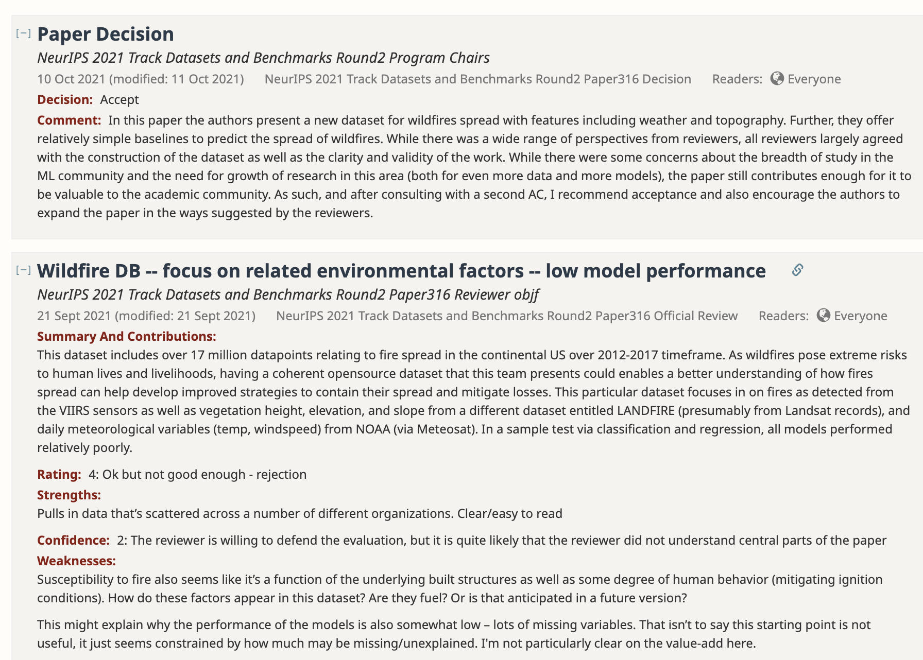
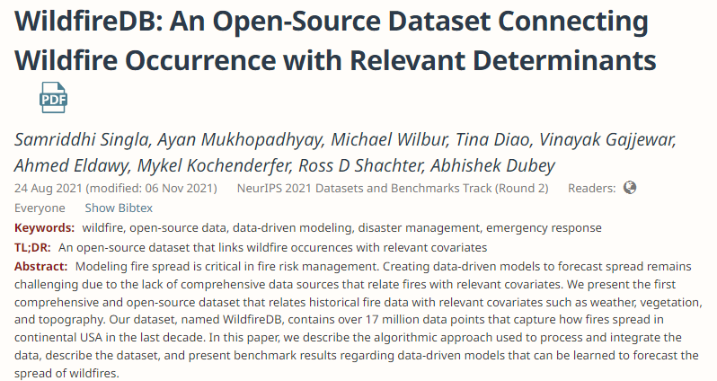
2. Task (Dataset)
We crawled all papers of conferences, workshops, and other academic events from openreview.net
Notes:
Now, I introduce our dataset.
In the open review, we can get many informations about a paper such as summary, Strength, Weakness, whether it is accepted or not.
Moreover, we can access the abstract and TL DR of the paper

Slide 10
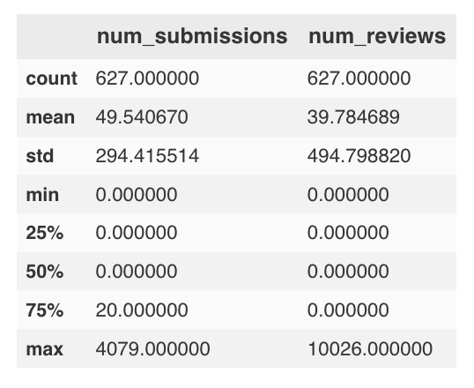
2. Task (Dataset)
We crawled all papers of conferences, workshops, and other academic events from openreview.net, but not included
Papers with no review
Papers only with the committee’s decision
After crawling, we excluded the papers that
Papers with reviews that don’t have strengths and weaknesses
Descriptive Statistics
Papers without strength and weakness
Total 627 academic events
Total 31,062 papers were submitted
49.5407 papers were submitted for each academic event in average
4079 papers were submitted for ICLR 2023
Total 10,026 reviews were replied in ICLR 2021
Notes:
Also, we didn’t include (1) papers with no review and (2) papers only with the committee’s decision into our dataset.
Moreover, we excluded the papers with review that don’t have strengths and weaknesses after crawling
There are 627 academic events in total at Openreview.net.
31,062 papers were submitted in total
Around 50 papers were submitted for each academic event in average
4079 papers were replied in ICLR 2023.
For papers without strength and weakness, 10,026 reviews were replied in ICLR 2021, which is the maximum number of reviews

Slide 11
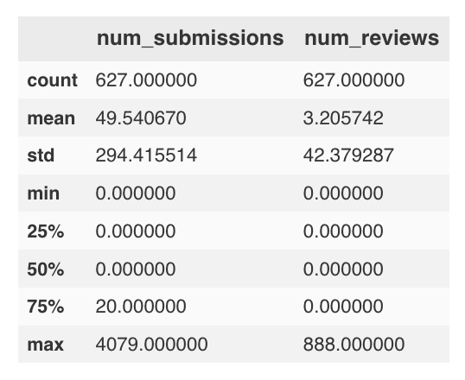
2. Task (Dataset)
We crawled all papers of conferences, workshops, and other academic events from openreview.net, but not included
Papers with no review
Papers only with the committee’s decision
After crawling, we excluded the papers that
Papers with reviews that don’t have strengths and weaknesses
Descriptive Statistics
Papers with strength and weakness
Total 627 academic events
Total 31,062 papers were submitted
49.5407 papers were submitted for each academic event in average
4079 papers were submitted for ICLR 2023
Total 888 reviews were replied in NeurIPS 2022
Notes:
On the other hand, for papers with strength and weakness, 888 reviews were replied in NeurIPS 2022, which is the maximum number of reviews
You can notice that there are less reviews with strength and weakness than those without strength and weakness

Slide 12
2. Task (Dataset)
Venues of the papers with pros-and-cons reviews were submitted
Venue | Number of papers | Number of reviews
MIDL 2022 | 98 | 312
NeurIPS 2021 Track - Datasets and Benchmarks (Round 1) | 66 | 207
NeurIPS 2021 Track - Datasets and Benchmarks (Round 2) | 109 | 402
NeurIPS 2022 Track - Datasets and Benchmarks | 163 | 888
NeurIPS 2022 Workshop TSRML | 87 | 201
Most of the venues are related to the Datasets and Benchmarks track
Notes:
These table represents academic events, of which reviews have strength and weakness.
As you can see, there are only 2 types of academic events, of which reviews have strengths and weakness.

Slide 13
Contents
1. Introduction
2. Task
3. Methods
4. Results and Discussion
5. Conclusions
Notes:
Now, we focus on methods parts

Slide 14
3. Methods
We use a famous natural language processing encoder BERT[2] as a backbone model for our model
BERT
Multi heads
Outputs
Paper
Summary
head
Summary
Strengths
head
Strengths
Abstract
Weakness
head
Weakness
Is_Accpeted
head
Is_Accpeted
[2] Devlin, Jacob, et al. "Bert: Pre-training of deep bidirectional transformers for language understanding." arXiv preprint arXiv:1810.04805 (2018).
Notes:
We use a famous natural language processing encoder BERT[2] as a backbone model
In other words, we use bert as an encoder and do 4 tasks using that encoder.

Slide 15
3. Methods
BERT with Summary head
BERT with Summary head
BERT with Summary head
Abstract
Abstract
Abstract
<Mask>
Attention
Attention
<Mask>
Is
…
All
You
Need
Need
.
Notes:
We use almost same model structure for 3 tasks
Therefore, we explain only one model to generate a summary in one sentence with this example.
We used MLM model for these tasks.
First, we predict the first token using the abstract.
After that, we predict next token of the world ‘Attention’, using the abstract and ‘Attention’
By iterating this process, we can get the one sentence summary.

Slide 16
3. Methods
BERT with Is_Accepted head
Is_Accepted
Abstract
Notes:
For the classification model for ‘Is_Accepted’, we train both an encoder and linear classifier.
By training this model, we can get the final classifier for ‘Is_Accepted’.

Slide 17
Contents
1. Introduction
2. Task
3. Methods
4. Results and Discussion
5. Conclusions
Notes:
Now, let’s talk about Results and Discussion

Slide 18
4. Results and Discussion
This table represents the paper acceptance confidence using the test data set.
 | Paper Acceptance Confidence
First token model | 0.5767
Last token model | 0.5488
Notes:
First token model uses the first token to calculate the logit value for Is_acceptance.
Last token model uses the last token to calculate the logit value for Is_acceptance.
As you can see, the performance of the first token model is better and hence, we choose this model as the final model for the classification of ‘Is_accepted’

Slide 19
4. Results and Discussion
Demo http://54.163.163.24:8501/
We qualitatively evaluated our model.
Notes:
If we enter the abstract of an paper, we can get the results of 4 tasks.
As you can see, the task ‘summarizing the paper in one sentence’ is good enough.
However, the performance for the other tasks are not good.
In other words, there are too many repeated words and sentences in the strengths and weaknesses.
Moreover, for the two submitted papers, our model predicts one would be accepted and the other would be not accepted.
For the two tasks, generating strengths and weaknesses, it is because we could not use the abstracts of various papers for learning because there was a lack of data with strengths and weaknesses.
For the task about Is_accepted, we thought the abstract was not enough to determine whether it would be accepted or not.

Slide 20
Contents
1. Introduction
2. Task
3. Methods
4. Results and Discussion
5. Conclusions
Notes:
Finally, conclusion.

Slide 21
5. Conclusions
We assumed that the abstract has enough information to analyze the paper.
So, we design 4 tasks to analyze the paper and conducted experiments.
It seems that we could understand the paper at some extent using only abstract and hence, many scientists could utilize our models in real world.
Also, we can improve the performances if we could use more high-quality data.
We can improve the performance if we use more sophisticated model.

Slide 22
Reference
[1] Qazvinian, Vahed, and Dragomir R. Radev. "Scientific paper summarization using citation summary networks." arXiv preprint arXiv:0807.1560 (2008).
[2] Devlin, Jacob, et al. "Bert: Pre-training of deep bidirectional transformers for language understanding." arXiv preprint arXiv:1810.04805 (2018).
Notes:
This is our references

Slide 23
Thank You
Notes:
and thank you for listening!

